Slide 1
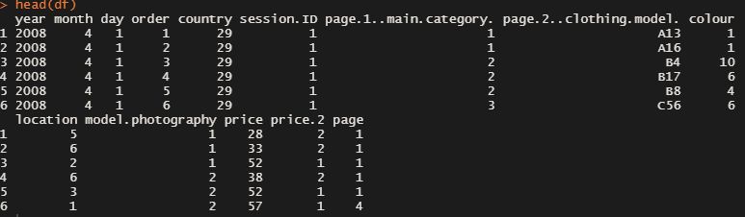
Exploratory Data Analysis Data Inspection
First 6 rows of data
Dimension: 165,474 rows x 14 columns
No missing data
Target Variable: price.2 (level 1 and 2)
Variables with 2 levels: model.photography & price.2
Continuous Variable: price
Dataset was in the period of April 2008 to August 2008

Slide 2
Columns | Explanation
year | Year is 2008
month | From April (4) to August (8)
day | Day number of the month
order | The sequence of clicks in one session
country | Indicating the country by identifying the origin of the IP Address
session.ID | ID of the session
page.1..main.category. | Main Product Category (1 to 4)
page.2..clothing.model. | Code for each product
colour | Colour of the product
location | Photo location on the page
model.photography | Model of the photo – enface or profile
price | Price in US Dollar
price.2 (Target Variable) | Variable informing whether price of the product is higher than the average price for the entire product category
page | Page number within the e-store website

Slide 3
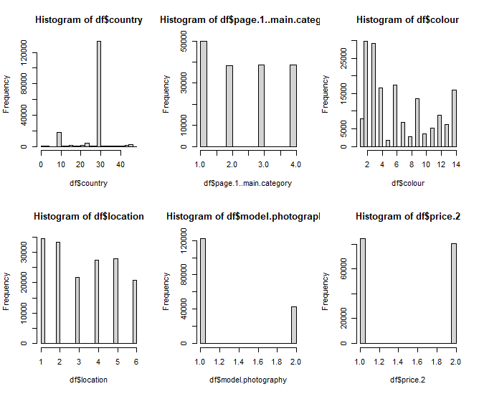
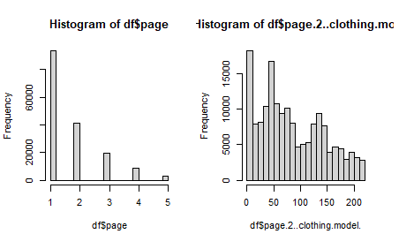
Most data is from Poland (country:29)
“price.2” has a ratio of 84695:80779
“page.2..clothing.model.” & “colour” skewed to the left

Slide 4
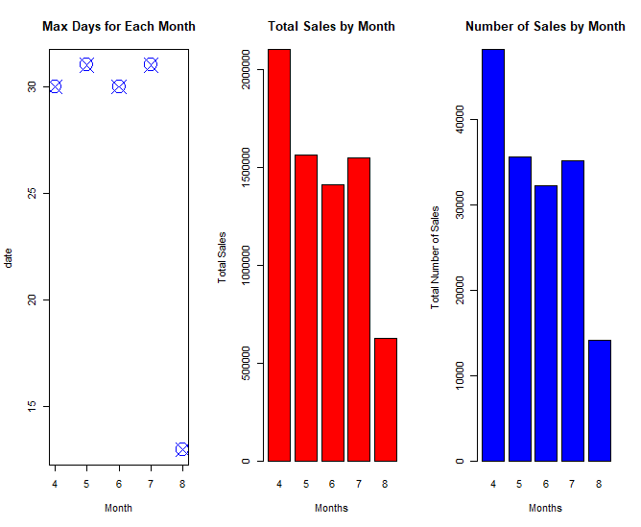
Exploratory Data Analysis Data Analysis

